Slide 1


Unit-01 Introduction to Web Technology & Web Designing
Web Designing (WD) (2301CS202)
Prof. Vijay M Shekhat
Department of Computer Science and Engineering
vijay.shekhat@darshan.ac.in
9558045778

Slide 2

Outline
Introduction to WEB
What is Internet?
What is WWW?
How the WEB works?
HTTP Protocol
Introduction to Web Technologies
HTML
CSS
JavaScript
Bootstrap
Material Design
Concepts of Effective Web Design
Web Design Issues
Planning a website
Effective Navigation
Looping

Slide 3
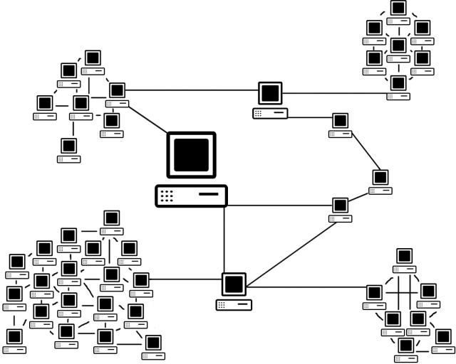
What is Internet?
The Internet is a massive network of networks, a networking infrastructure.
It connects millions of computers together globally, forming a network in which any computer can communicate with any other computer as long as they are both connected to the Internet.
Information that travels over the Internet uses many different set of rules which are known as protocols.

Slide 4
What is WWW?
WWW stands for World Wide Web.
A technical definition of the WWW is − All the resources and users on the Internet that are using HTTP.
HTTP stands for Hypertext Transfer Protocol which is a text-based request-response protocol.
HTTP is an application layer protocol that allows web-based applications to communicate and exchange the data.
HTTP is a TCP/IP based protocol, so it also is a connectionless and stateless protocol.
After making the request, the client disconnects from the server, then when the response is ready the server re-establish the connection again and deliver the response.
HTTP is the protocol being used to transfer hypertext documents that makes the World Wide Web possible.

Slide 5

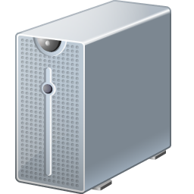

How the Web Works?
World Wide Web (WWW) use classical client / server architecture.
Server running Web Server Software (Apache, IIS, Tomcat, etc.)
Client running a Web Browser
HTTP
Page request
HTTP
Server response

Slide 6
HTTP request
The HTTP request message consist of following,
A request line (e.g. GET /index.php HTTP1.1)
Request header fields (e.g. Accept-Language: en)
An empty line (CRLF)
An optional message body
The request line and other header fields must end with CRLF (Carriage return, Line Feed) (/r/n)
A request line contains the method of request followed by the resource we want and at the end protocol version used.
HTTP Request Methods: GET, POST, PUT, DELETE etc...
There are many request header fields available with HTTP Request, some of are listed below
Accept : Media type(s) that is/are acceptable for the response. (e.g. Accept: text/html)
Accept-Charset: Character sets that are acceptable. (e.g. Accept-Charset: utf-8)
Date: The date and time at which the message was originated (e.g. Date: Tue, 15 Nov 1994 08:12:31 GMT)
Host: The domain name of the server (e.g. Host: darshan.ac.in)
User-Agent: details of the browser used (e.g. User-Agent: Mozilla/5.0 (Windows NT 10.0; Win64; x64) AppleWebKit/537.36 (KHTML, like Gecko) Chrome/88.0.4324.150 Safari/537.36)

Slide 7
HTTP Request (Example)
GET /index.php HTTP/1.1 |  | index.php is requested from server using GET method of HTTP version 1.1
User-Agent: Mozilla/5.0 (Windows NT 10.0; Win64; x64) AppleWebKit/537.36 (KHTML, like Gecko) Chrome/88.0.4324.150 Safari/537.36 |  | Version 5.0 of mozila browser is used on windows 10 (64 bit) while requesting the page from the server.
Host: www.darshan.ac.in |  | Host of the requested page is www.darshan.ac.in
Accept-Language: en-us |  | Client accepts US English locale while receiving the response from the server.
Accept: text/html |  | Client accepts text file containing the HTML in it while receiving the response from the server.

Slide 8
HTTP Response
After receiving and interpreting a HTTP request message, a server responds with an HTTP response message.
The HTTP response message consist of following,
Status-Line (format= HTTP-Version SP Status-Code SP Reason-Phrase CRLF)
*(( general-header | response-header | entity-header ) CRLF)
An empty line (CRLF)
An optional message body
Status-Line consist of
HTTP-Version, which can be HTTP/1.1
Status-Code is a 3 digit code which is in below format
1xx: Informational - Request received, continuing process
2xx: Success - The action was successfully received, understood, and accepted
3xx: Redirection - Further action must be taken in order to complete the request
4xx: Client Error - The request contains bad syntax or cannot be fulfilled
5xx: Server Error - The server failed to fulfill an apparently valid request
Reason-Phase is a textual representation of the status code in human readable format.

Slide 9

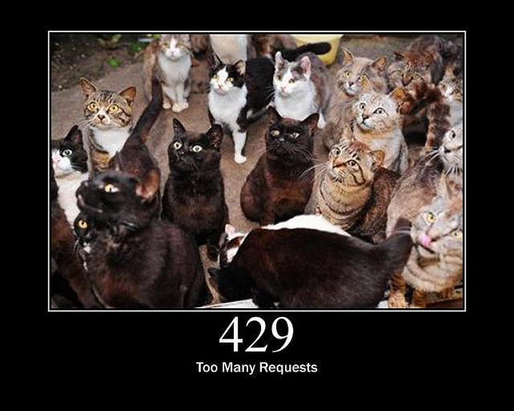
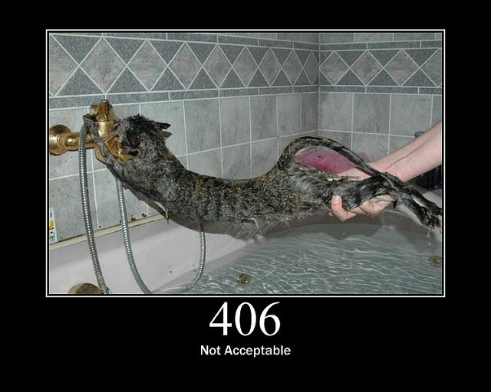
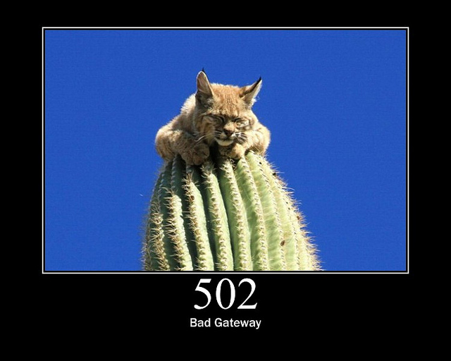
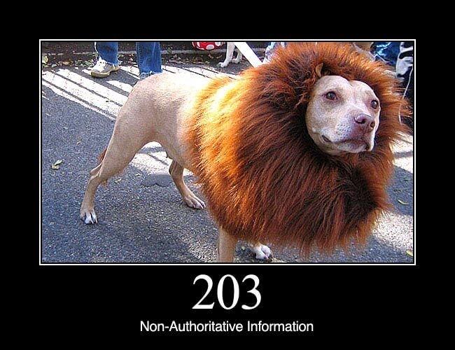
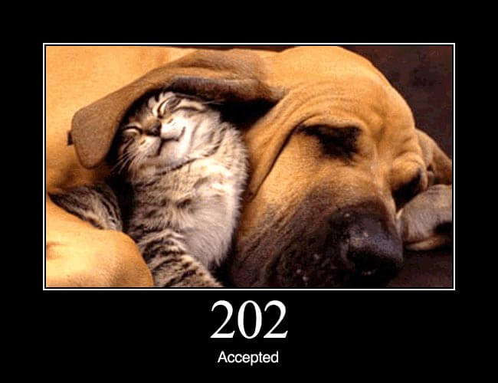
HTTP Status Codes with reason phrase
"100": Continue
"101": Switching Protocols
"200": OK
"201": Created
"202": Accepted
"203": Non-Authoritative Information
"204": No Content
"205": Reset Content
"206": Partial Content
"300": Multiple Choices
"301": Moved Permanently
"302": Found
"303": See Other
"304": Not Modified
"305": Use Proxy
"307": Temporary Redirect
"400": Bad Request
"401": Unauthorized
"402": Payment Required
"403": Forbidden
"404": Not Found
"405": Method Not Allowed
"406": Not Acceptable
"407": Proxy Authentication Required
"408": Request Time-out
"409": Conflict
"410": Gone
"411": Length Required
"412": Precondition Failed
"413": Request Entity Too Large
"414": Request-URI Too Large
"415": Unsupported Media Type
"416": Requested range not satisfiable
"417": Expectation Failed
"500": Internal Server Error
"501": Not Implemented
"502": Bad Gateway
"503": Service Unavailable
"504": Gateway Time-out
"505": HTTP Version not supported
Refer: https://www.w3.org/Protocols/rfc2616/rfc2616-sec6.html for more details on HTTP Status Code

Slide 10
HTTP Response (Example)
HTTP/1.1 200 OK |  | Response is 200 status code with OK message using HTTP1.1
Date: Mon, 27 Jul 2009 12:28:53 GMT |  | Response Date & Time
Server: Apache/2.2.14 (Win32) |  | Webserver used by server is Apache and version is 2.2.14 built for 32bit OS
Last-Modified: Wed, 22 Jul 2009 19:15:56 GMT |  | Last modified at Date & Time.
Content-Length: 88 |  | Content size of the response is 88 bytes
Content-Type: text/html |  | Content type of the response is text file containing HTML

Slide 11
Introduction to Web Technologies
HTML
HTML stands for Hypertext Markup Language.
It is used to design the front-end portion of web pages using a markup language.
HTML is the combination of Hypertext and Markup language. Hypertext defines the link between the web pages. The markup language is used to define the text documentation within the tag which defines the structure of web pages.
CSS
Cascading Style Sheets fondly referred to as CSS is a simply designed language intended to simplify the process of making web pages presentable.
CSS allows you to apply styles to web pages.
More importantly, CSS enables you to do this independent of the HTML that makes up each web page.
JavaScript
JavaScript is a famous scripting language used to create magic on the sites to make the site interactive for the user.
It is used to enhancing the functionality of a website to running cool games and web-based software.

Slide 12
Introduction to Web Technologies (Cont.)
Bootstrap
Bootstrap is the most popular HTML, CSS, and JavaScript framework for developing responsive, mobile-first websites.
Bootstrap is completely free to download and use! The primary purpose of adding it to a web project is to apply Bootstrap's choices of color, size, font and layout to that project.
As such, the primary factor is whether the developers in charge find those choices to their liking.
Once added to a project, Bootstrap provides basic style definitions for all HTML elements.
Material Design
Material Design is a design system created by Google to help teams build high-quality digital experiences for Android, iOS, Flutter, and the web.
Material Design is inspired by the physical world and its textures, including how they reflect light and cast shadows.

Slide 13
Concept of Effective Web Design
It's a good idea to first think about and design your site. That way, you'll give yourself direction and you'll need to reorganize less later.
To design your site:
Figure out why you're creating this site. What do you want to convey?
Think about your audience. How can you tailor your content to appeal to this audience? For example, should you add lots of graphics or is it more important that your page download quickly?
How many pages will you need? What sort of structure would you like it to have? Do you want visitors to go through your site in a particular direction, or do you want to make it easy for them to explore in any direction?
Sketch out your site on paper.
Devise a simple, consistent naming system for your pages, images and other external files.

Slide 14
Web Design Issues
Browser & Operating Systems
Bandwidth and Cache
Display Resolution
Look & Feel
Page Layout and Linking
Locating Information
Making Design user-Centric
Sitemap

Slide 15
a) Browser & Operating Systems
Web pages are written using different HTML tags and viewed in browser window.
The different browsers and their versions greatly affect the way a page is rendered, as different browsers sometimes interpret same HTML tag in a different way.
Different versions of HTML also support different sets of tags.
The support for different tags also varies across the different browsers and their versions.
Same browser may work slightly different on different operating system and hardware platform.
To make a web page portable, test it on different browsers on different operating systems.

Slide 16
b) Bandwidth and Cache
Users have different connection speed, i.e. bandwidth, to access the Web sites.
Connection speed plays an important role in designing web pages, if user has low bandwidth connection and a web page contains too many images, it takes more time to download.
Generally, users have no patience to wait for longer time than 10-15 seconds and move to other site without looking at contents of your web page.
Browser provides temporary memory called cache to store the graphics.
When user gives the URL of the web page for the first time, HTML file together with all the graphics files referred in a page is downloaded and displayed.

Slide 17
c) Display Resolution
Display resolution is another important factor affecting the Web page design, as we do not have any control on display resolution of the monitors on which user views our pages.
Display or screen resolution is measured in terms of pixels and common resolutions are 800 X 600 and 1024 X 786.
We have three choices for Web page design.
Design a web page with fixed resolution.
Make a flexible design using HTML table to fit into different resolution.
If the page is displayed on a monitor with a higher resolution, the page is displayed on left hand side and some part on the right-hand side remains blank. We can use centered design to display page properly.
Ideally we should use some frameworks for designing like Bootstrap/Material design.

Slide 18
d) Look & Feel & e) Page Layout and Linking
Look & Feel
Look and feel of the website decides the overall appearance of the website.
It includes all the design aspects such as
Web site theme
Web typography
Graphics
Visual structure
Navigation etc…
Page Layout and Linking
Website contains of individual web pages that are linked together using various navigational links.
Page layout defines the visual structure of the page and divides the page area into different parts to present the information of varying importance.
Page layout allows the designer to distribute the contents on a page such that visitor can view it easily and find necessary details.

Slide 19
f) Locating Information & g) Making Design User-Centric
Locating Information
Webpage is viewed on a computer screen and the screen can be divided into five major areas such as center, top, right, bottom and left in this particular order.
The first major area of importance in terms of users viewing pattern is the center, then top, right, bottom and left in this particular order
Making Design User-Centric
It is very difficult for any Web designer to predict the exact behavior of the Web site users.
However, idea of general behavior of common user helps in making design of the Web site user centric.
Users either scan the information on the web page to find the section of their interest or read the information to get details.

Slide 20
h) Sitemap
A Sitemap is a model of a website's content designed to help both users and search engines navigate the site.
Many a times Web sites are too complex as there are a large number of sections and each section contains many pages.
It becomes difficult for visitors to quickly move from one part to other.
Once the user selects a particular section and pages in that section, user gets confused about where he/she is and where to go from there.
To make it simple, keep your hierarchy of information to few levels or provide the navigation bar on each page to jump directly to a particular section.

Slide 21
Planning a Website
The most important activity in a website development is planning.
To achieve higher success of the website in terms of user satisfaction, better planning is needed.
Before we start developing a website, we should ask question such as,
Why are we developing this website?
What do we achieve by developing this website?
Who are the people who will use this website?
What are the information contents?
How are these contents organized? What are the possible ways?

Slide 22
Effective Navigation
The most important design element in the web design after page layout is navigation design.
Navigation means the ways to move from one page to another page in a Web site using hyperlinks provided on the page.
If navigation design is not proper then user feels the problem in moving around the pages in your site in a desired manner or gets confused and leaves the site.
Tips for Effective Navigation:
Navigation links are either text based, i.e. a word or a phrase, or graphical, i.e. a image.
Navigation links should be clear and meaningful.
It should be consistent.
Link should be understandable.
Organize the links such that contents are grouped logically.
Provide search link, if necessary, usually on top of the page.
Use common links such as ‘about us’ or ‘Contact us’.
Provide the way to return to first page.
Provide the user with information regarding location.
Horizontal navigation bar can be provided on each page to directly jump to any section.

Slide 23
Web Designing (WD) (2301CS202)
Prof. Vijay M Shekhat
Department of Computer Science and Engineering
vijay.shekhat@darshan.ac.in
9558045778

